Slide 1
ESA report to CEOS/WGCV/LPV
Ferran Gascon
15 May 2019, LPS19, Milan

Slide 2
Validation Approach
The validation activities have two main goals:
the first one is to provide products with documented and associated traceable error bars;
the second goal is to gain knowledge in the algorithm and sensor characteristics in order to improve their quality and reliability.
The accuracy in the uncertainties has a long term impact for most EO applications and in particular for climate applications.
The validation activities are a key component of a Mission, as it is the foundation for user credibility into the mission data. Validation activities require continuous effort during and after the mission life time.

Slide 3
Validation Approach
A validation program is composed by a set of different complementary activities bringing elements that need to be combined together in order to produce consolidated and confident validation results.
In a generic manner the different components for a validation program are the following:
Validation against precise Fiducial Reference Measurements (FRM): few points but precise;
Validation against in-situ: more points less precise;
Validation against others sources: inter-satellite comparison;
Validation against models: data assimilation rejection statistics, integrated model analyses…;
Validation using Level 3 data (i.e. merged data): statistical comparison between various Level 3 from various sensors constitutes an extremely useful tool (mean, median, sd, bias, RMS…. for selected zones, transects, latitudinal bands, seasonal trends… ) for a cross-validation of the products;
Validation using monitoring tools: statistics, trend, systematic quality control, etc.
Notes:
All the components are important and necessary; the first point (FRM) is of particular importance because it gives a reference properly characterised and traceable to standard on which the Validation results can be anchored.

Slide 4
Fiducial Reference Measurements
“The suite of independent ground measurements that provide the maximum Return On Investment (ROI) for a satellite mission by delivering, to users, the required confidence in data products, in the form of independent validation results and satellite measurement uncertainty estimation, over the entire end-to-end duration of a satellite mission.”
Following the QA4EO principles, the defining mandatory characteristics for FRM are:
FRM measurements have documented SI traceability (e.g. via round-robin characterisation and regular, pre-and post deployment, calibration of instruments) using metrology standards,
FRM measurements are independent from the satellite geophysical retrieval process,
An uncertainty budget for all FRM instruments and derived measurements is available and maintained,
FRM measurement protocols, procedures and community-wide management practices (measurement, processing, archive, documents etc.) are defined, published openly and adhered to by FRM instrument deployments,
FRM are accessible to other researchers allowing independent verification of processing systems,
FRM are required to determine the on-orbit uncertainty characteristics of satellite geophysical measurements via independent validation activities.

Slide 5
FRM4 projects
http://www.frm4sts.org/ |  | Preparing ground truth radiometers and drifting buoy as FRM (SI Traceability) → SST, LST
https://frm4soc.org |  | Preparing above water radiometers and vicarious infrastructure in Europe for Ocean Colour FRM (SI Traceability) → OC
http://www.frm4alt.eu/ |  | Procedures and approached to maintain ground transponders (with SI Traceability) → Topography
http://frm4ghg.aeronomie.be/ |  | The focus of the “FRM Ground-Based FTIR Greenhouse Gas Observations” (FRM4GHG) project is the intercomparison of instruments and harmonization of products and retrievals from ground based FTIR systems → Greenhouse Gas
http://frm4doas.aeronomie.be/ |  | The “FRM for Ground-Based DOAS Air-Quality Observations” (FRM4DOAS) project aims at the harmonization of the retrievals from UV-Visible ground based spectrometers, e.g., MAXDOAS or Pandora, in view of reaching the standards of FRMs for NO2 and ozone.
https://frm4veg.org/ |  | Best practice for deploying an a site (and analysis) for accurate geometric calibration.
Notes:
SI for transponder is the time (for range measurement).

Slide 6
Validation Priorities
Continue FRM4 projects and extend to other geophysical variables.
Advance in the definition of FRM protocols and propose them at CEOS/WGCV/LPV for community endorsement.
Contribute to the development of a network of validation super-sites for land geophysical variables with permanent measurements. ESA will support 2 validation super-sites in Europe.

Slide 7
Conclusions
A validation approach has been defined for ESA missions.
In line with QA4EO guidelines and CEOS WGCV.
Plans are in place for Fiducial Reference Measurement (FRM) qualification.
Activities started and will start to provide with FRMs.
Cal/Val information, FRM projects:
→ https://earth.esa.int/web/sppa/home
ESA priorities on FRM projects, protocols definition and super-site deployment for land variables.

Slide 8
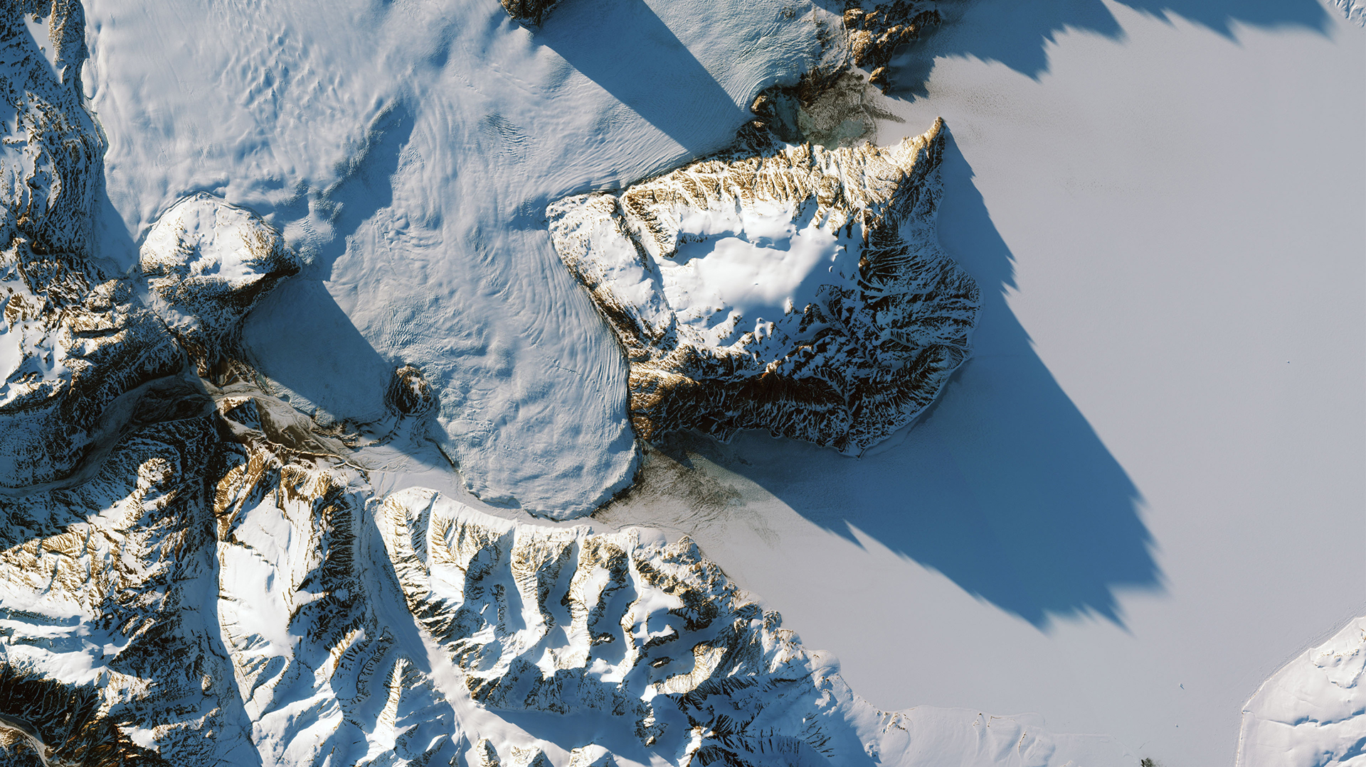
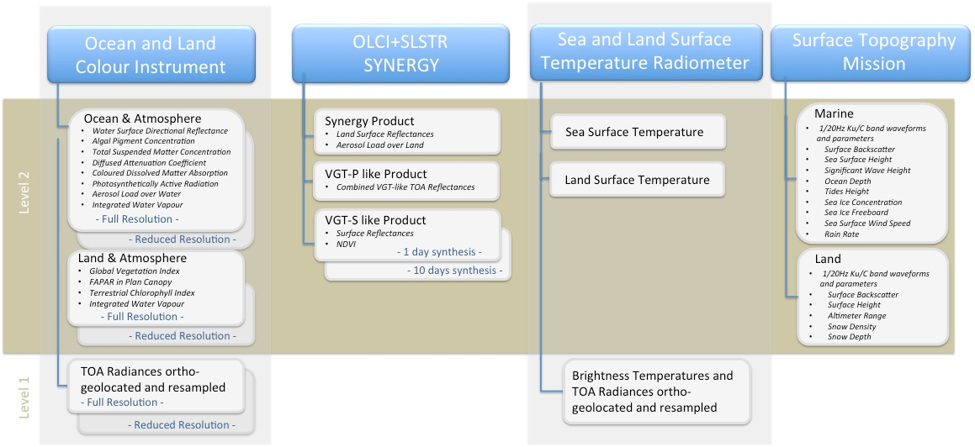
Sentinel-3: core data products
over ocean

